Slide 1
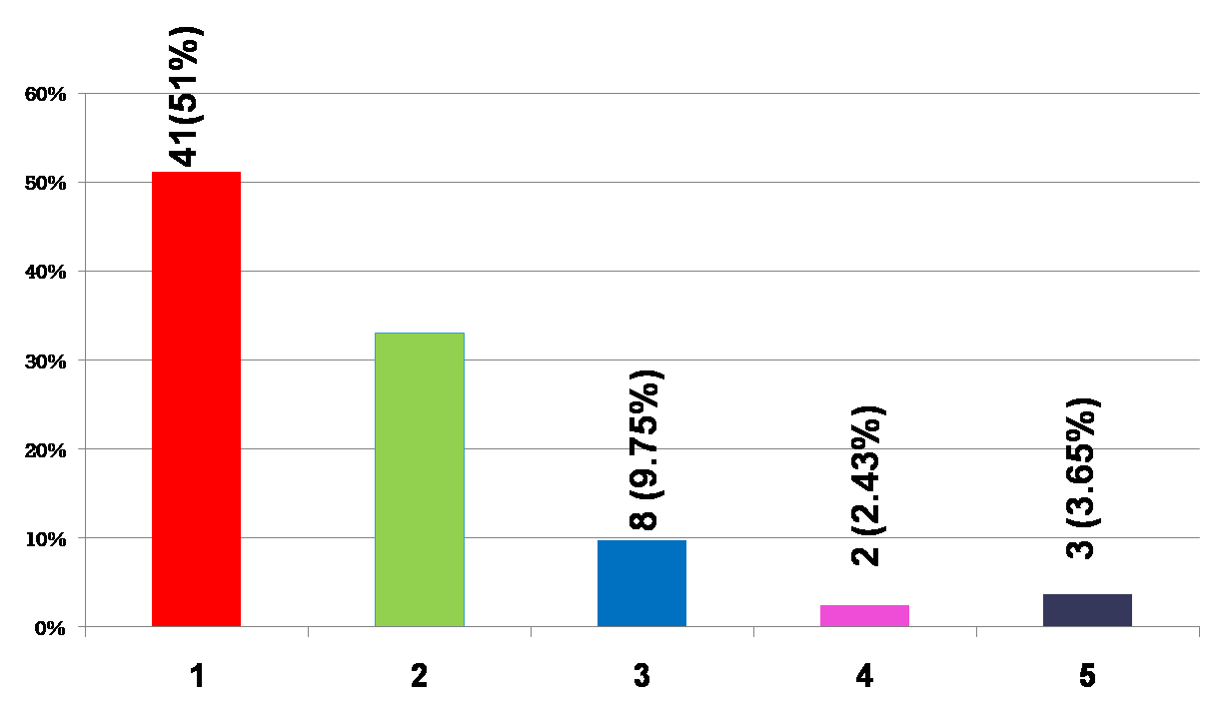
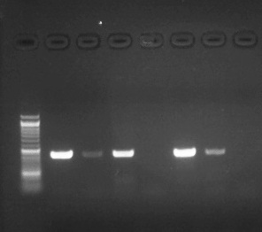
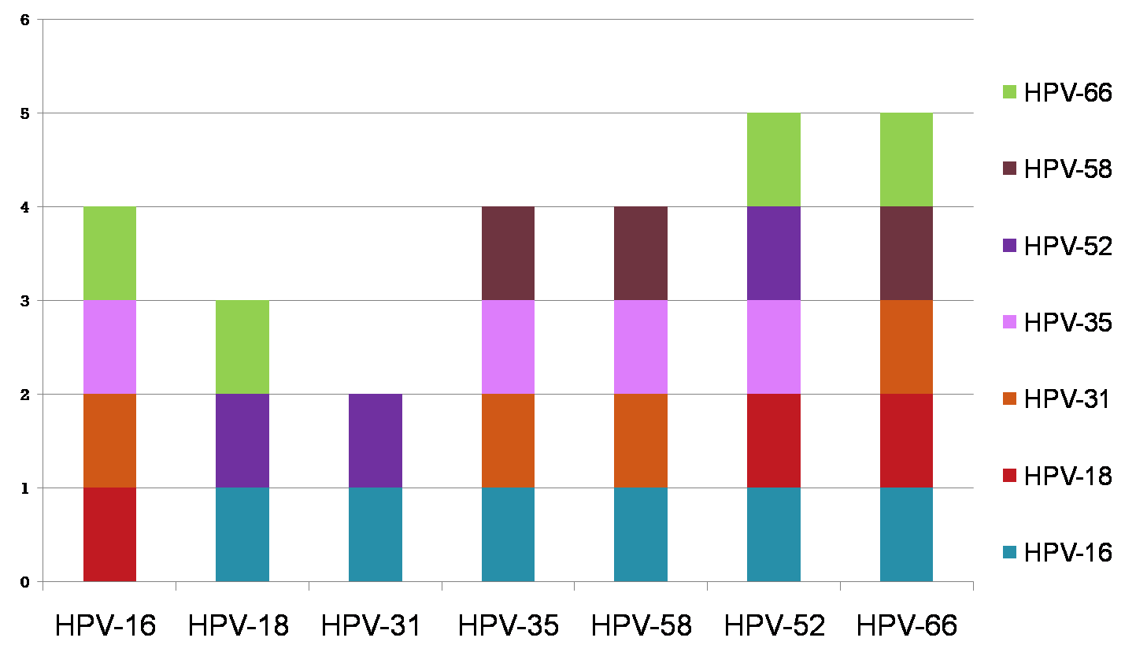
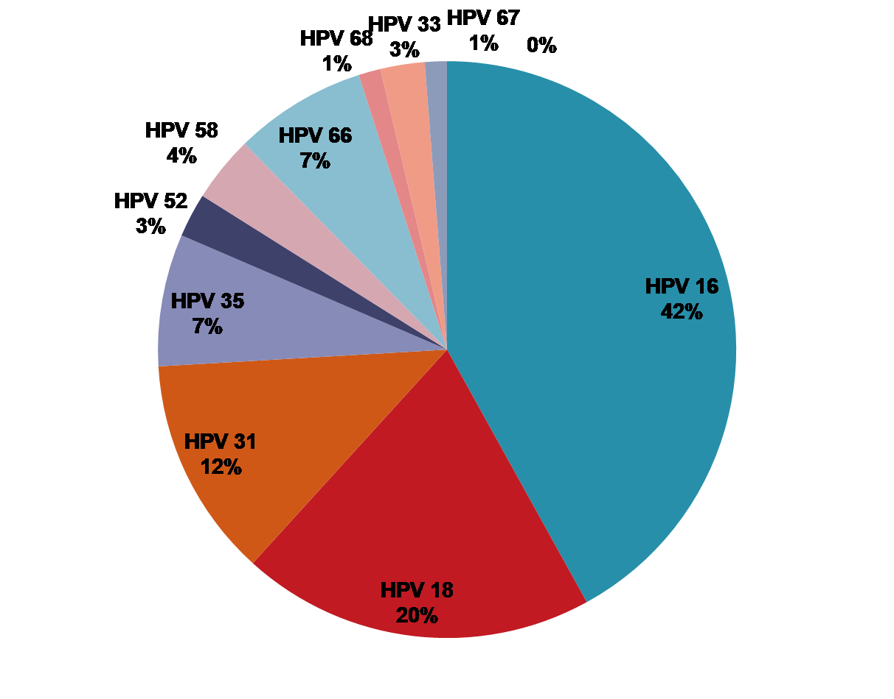
Anal cytological abnormalities and HPV detection with different primer sets in HIV-positive men in eastern India
Abhilasha Gautam1, Jaya Chakravarty1, Navneet Agarwal1, Amrita Ghosh2, Madhukar Rai1
1 Department of Medicine, Institute of Medical Sciences, Banaras Hindu University, Varanasi 221005, India , 2 Department of Pathology, Institute of Medical Sciences, Banaras Hindu University, Varanasi 221005, India
Background
Oncogenic Human papillomavirus (HPV) infections are closely associated with anal cancer which is high among human immunodeficiency virus (HIV) infected males. Despite the known high risk of anal cancer in HIV positive men, there are very few studies in India regarding the prevalence of HPV in this population.
Currently there are no recommended screening methods for HPV infections, In studies that used PCR method, HPV presence was found in 78-88% anal cancer specimens,.
HPV detection rate is affected by choice of consensus primer selection.
Aim
The aim of this cross-sectional study was to detect Human papillomavirus (HPV) infection by four different consensus primers in HIV positive treatment naïve males attending the ART centre.
Materials and methods
This cross sectional study was carried out between 2016-2017 in 102 HIV positive treatment naïve men attending the ART centre, BHU, Varanasi, India.
The study was approved from the Ethics committee of IMS, BHU. A written informed consent was obtained from all the participants.
The Anal Cytology were classified according to Bethesda system.
NORMAL - No Cell Changes
NILM - Negative for Intraepithelial Lesions
ASCUS - Atypical Squamous Cells Of Undetermined Significance
LSIL - Low-grade Squamous Intraepithelial Lesions
HSIL - High-grade Squamous Intraepithelial Lesions.
Four different consensus primer sets MY09/11, GP5+/ GP6+, E6 and E6/E7 were used to amplify broad spectrum HPV types.
HPV genotype (16, 18, 31, 35, 52, 58, 66, and 68) was determined by SYBR Green based real-time PCR method.
Risk factors were analyzed by using univariate and multivariate logistic regression models.
Sample processing
Cells from anal canal(Pap Smear) collected from 102 HIV-1 infected men
DNA Isolation (QIAamp DNA Blood Mini Kit (QIAGEN, Hilden, Germany)
PCR with different consensus primers*(MY09/11, GP5+/ GP6+ ,E6 and E6/E7)
{Veriti 96 Well
Thermal Cycler (Applied Biosystems)}
HPV genotype (16, 18, 31, 35, 52, 58, 66, and 68) was determined by SYBR Green based real-time PCR method.
Results
The overall HPV prevalence was 79.41% (81/102). The detection rate for each primer set was 65 (80%) with E6/E7, 54 (67%) E6, 49 (60.49%) GP5+/6+ and 44 (54.32%) with MY09/11. Only 14 (13.72%) subjects were HPV positive for all four primer sets.
The most prevalent HPV types were HPV-16, 18, 31, 35, and 52 (42%, 20%, 12%, 7% and 3% respectively) and multiple HPV types were identified in 36.58% (30/81).
Prevalence of anal cytological abnormalities was 54.5% (48/88). HSIL (high-grade squamous intraepithelial lesions) was present in 1.13% (1/88), LSIL (low-grade squamous intraepithelial lesions) in 26.13% (23/88), ASCUS (atypical squamous cells of undetermined significance) in 14.77% (13/88), ASC-H (atypical squamous cells cannot exclude a HSIL) in 12.5% (11/88).
40 (45.45%) slides were negative for any cytological abnormalities
Among those with abnormal cytology (ASCUS, LSIL and HSIL) 92% (44/48) were positive for HPV-DNA high prevalence.
Risk factors for anal cytological abnormalities were history of anal intercourse and age <19 yr at first intercourse on multivariate analysis.
HPV Screening Results
Table 1. Baseline characteristics and risk factor analysis
Frequency of single and multiple HPV genotypes
Fig. 5: Combination of HPV multiple genotypes in tested samples
Conclusions
HPV detection rate is also affected by the consensus primer selection E6/E7 consensus primer was the most suitable primer for detection of oncogenic HPV.
In our present study, the prevalence of HPV infection and anal cytological abnormality in male was found to be 79% and 55% respectively, which is very high.
Therefore, our study suggests that regular HPV testing should be done in HIV positive males in the ART center.
Acknowledgement
We would like to extend our thanks to UPSACS (Uttar Pradesh State AIDS control society) for their cooperation. Authors also offer sincere thanks to all the patients and staffs of ART centre who participated in this research work.
Characteristics | Univariate OR (95%CI) | p-value | Multivariate OR (95%CI) | p-value
Age >35 years <35 years | 1 0.443(0.173-1.135) | 0.090
Anal Intercourse Absent Present | 1 7.857(2.881-21.429) | <0.001 | 4.977 (1.653-14.984) | 0.004
No Sexual partner Single > one | 1 0.921(0.363-2.340) | 0.863
Age at first Intercourse >19(years) <19(years) | 1 3.543(1.452-8.648) | 0.005 | 2.966(1.029-8.546) | 0.044
HPV PCR Absent Present | 1 3.545(1.363-9.220) | 0.009 | 2.503(0.650-9.636) | 0.182
CD4 count >350/µl <350/µl | 1 1.360(0.539-3.433) | 0.515
Smoking Non smoker Smoker | 1 2.436 (1.001-5.926) | 0.050 | 2.189 (0.768-6.239) | 0.143
Alcohol intake Non Alcoholic Alcoholic | 1 1.128(0.481-2.647) | 0.782
Number of infected subjects
27 (33%)
250bp
450bp
E6 PCR
MY09/11 PCR
Number of HPV types
Table 2. HPV types and Anal Cytology in HIV and HPV-positive samples
Fig. 4: Distribution of single and multiple HPV types in HIV positive men
142bp
650bp
Combination of HPV genotypes in tested samples
GP5+/6+ PCR
E6/E7 PCR
Fig. 1 Gel electrophoresis pattern of HPV by using four consensus primers amplification.
Number of HPV types
Type of HPV | Anal Cytology (%)
N=102 | N=88 | Normal N=40 | ASCUS N=13 | ASC-H N=11 | LSIL N=23 | HSIL N=1 | Inadequate smear N=14
HPV-16 | 34 | 12 (30%) | 6 (46.15%) | 4 (36.36%) | 8 (35%) | 0% | 4 (29%)
HPV-18 | 16 | 3 (7.5%) | 2 (15.38%) | 3 (27.27%) | 4 (17.39%) | 1 (100%) | 3 (21.42%)
HPV-31 | 10 | 3 (7.5%) | 1 (8%) | 2 (15.38%) | 4 (17.39%) | 0% | 0%
HPV-35 | 6 | 4 (10%) | 0% | 0% | 1 (4.34%) | 0% | 1 (7.14%)
HPV-52 | 2 | 1 (2.5%) | 1 (8%) | 0% | 0% | 0% | 0%
HPV-58 | 3 | 1 (2.5%) | 0% | 1 (8%) | 1 (4.34%) | 0% | 0%
HPV-66 | 6 | 1 (2.5%) | 2 (15.38%) | 0% | 2 (13.04%) | 0% | 1 (7.14%)
HPV-68 | 1 | 0% | 0% | 0% | 1 (4.34%) | 0% | 0%
HPV-33 | 2 | 2 (5%) | 0% | 0% | 0% | 0% | 0%
HPV-67 | 1 | 1 (2.5%) | 0% | 0% | 0% | 0% | 0%
HPV-Negative | 21 | 12 | 1 | 1 | 2 | 0 | 5
Fig. 2: HPV genotyping distribution
PRESENTED AT THE 23RD INTERNATIONAL AIDS CONFERENCE (AIDS 2020) | 6-10 JULY 2020

